Slide 1


NEUBRIA
NEUBRIA
NOW
IN
STOCK!!
HEALTH AND WELLNESS DIVISION

Slide 2

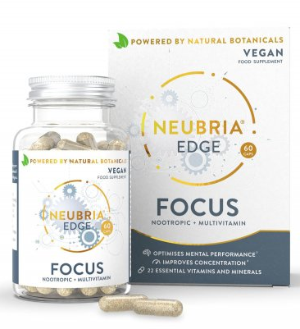
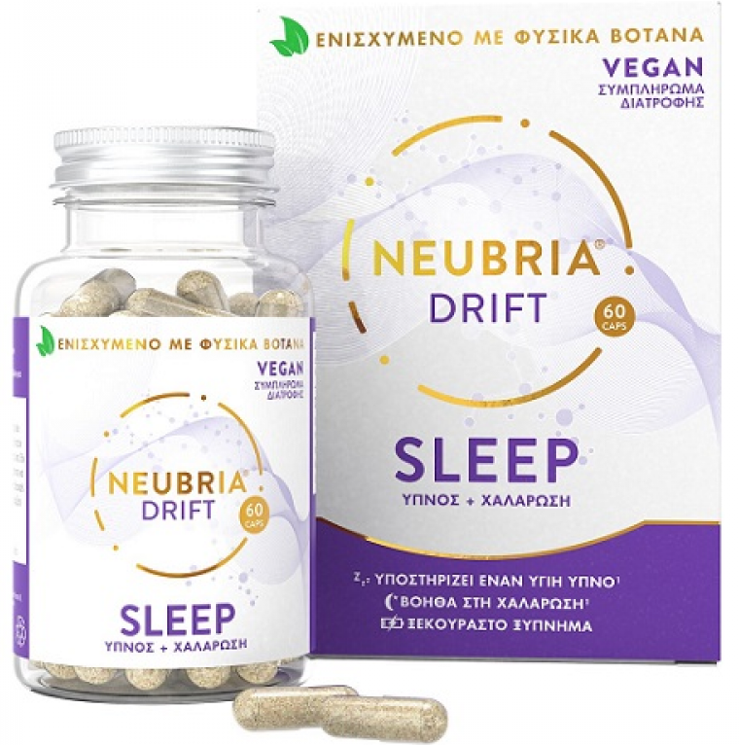

NEUBRIA
PRODUCT DESCRIPTION | UNIT SIZE | UNIT PRICE | EXPIRY DATE | BARCODE
NEUBRIA EDGE (FOCUS) | 60 | $2,495.00 | 31 MAY 2025 | 5060552880029
NEUBRIA SPARK (MEMORY) | 60 | $2,495.00 | 31 OCT 2026 | 5060552880005
NEUBRIA DRIFT (SLEEP) | 60 | $2,195.00 | 30 JUN 2025 | 5060552880043

Slide 3
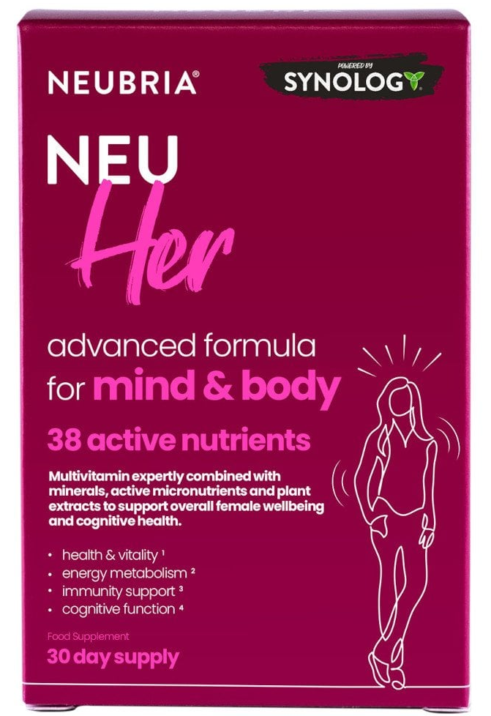
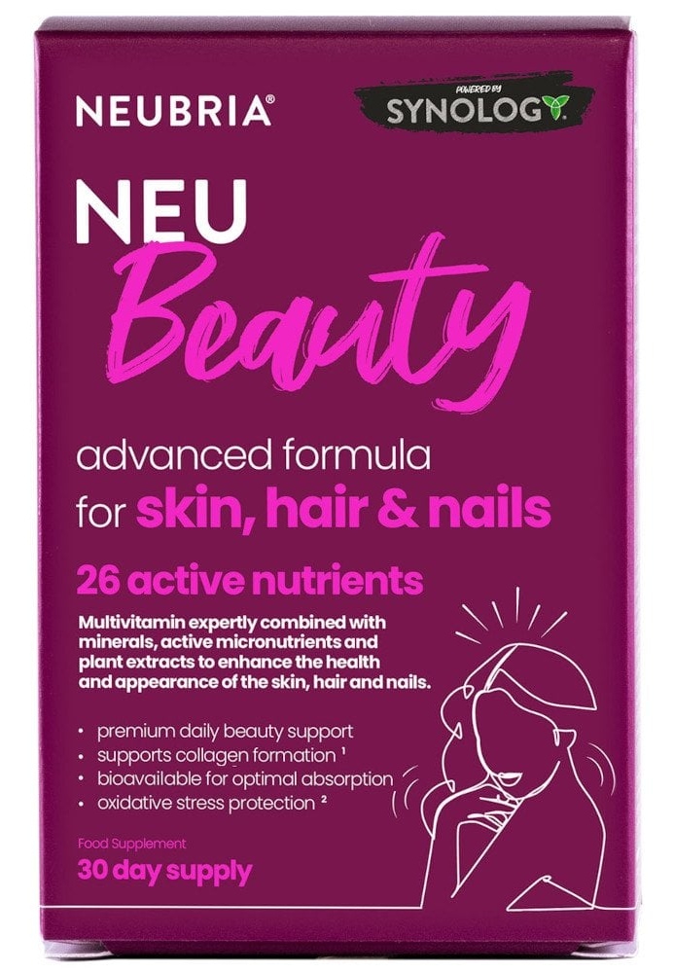
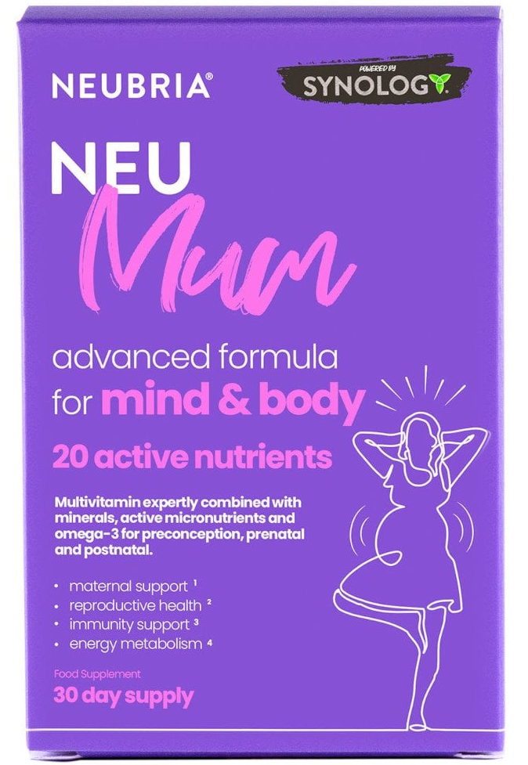
NEUBRIA
PRODUCT DESCRIPTION | UNIT SIZE | UNIT PRICE | EXPIRY DATE | BARCODE
NEUBRIA NEU HER | 30 | $1,295.00 | 30 JUN 2025 | 5060552880814
NEUBRIA NEU BEAUTY | 30 | $1,295.00 | 30 JUN 2025 | 5060552880845
NEUBRIA NEU MUM | 30 | $1,295.00 | 31 JUL 2025 | 5060552880821

Slide 4
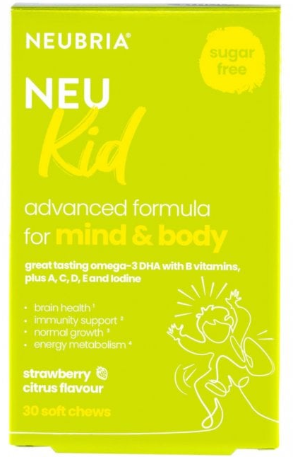
PRODUCT DESCRIPTION | UNIT SIZE | UNIT PRICE | EXPIRY DATE | BARCODE
NEUBRIA NEU KID (CHEWABLE) | 30 | $1,295.00 | 31AUGUST 2025 | 506055288052

Slide 5
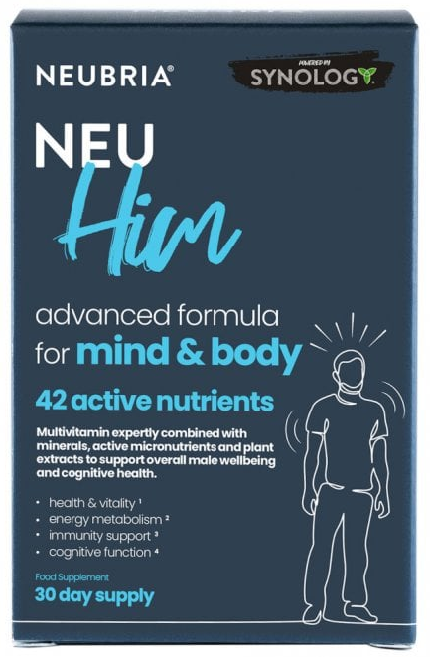
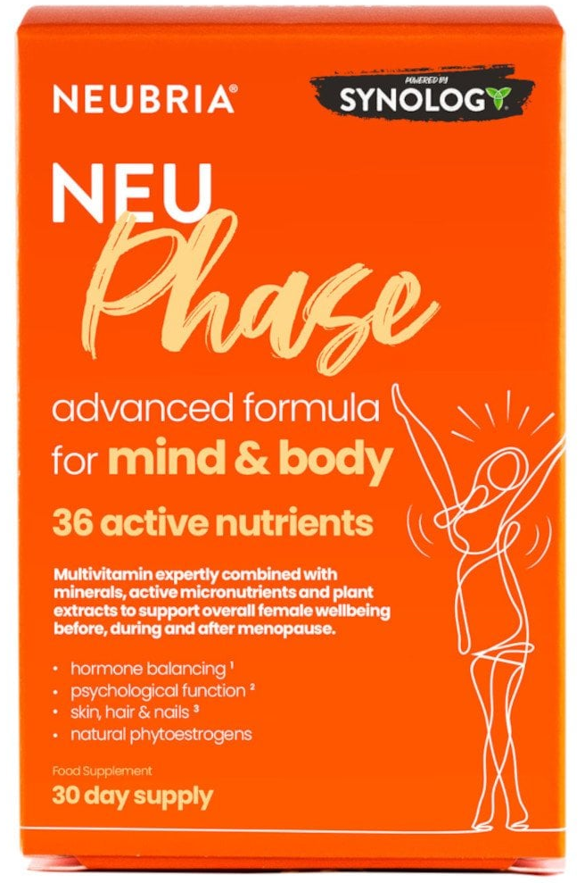

PRODUCT DESCRIPTION | UNIT SIZE | UNIT PRICE | EXPIRY DATE | BARCODE
NEUBRIA NEU HIM | 30 | $1,295.00 | 30 JUN 2025 | 5060552880807
NEUBRIA NEU PHASE | 30 | $1,295.00 | 30 JUN 2025 | 5060552880838
NEUBRIA CHARGE (ENERGY) | 60 | $1,995.00 | 30 JULY 2025 | 5060552880050

Slide 6
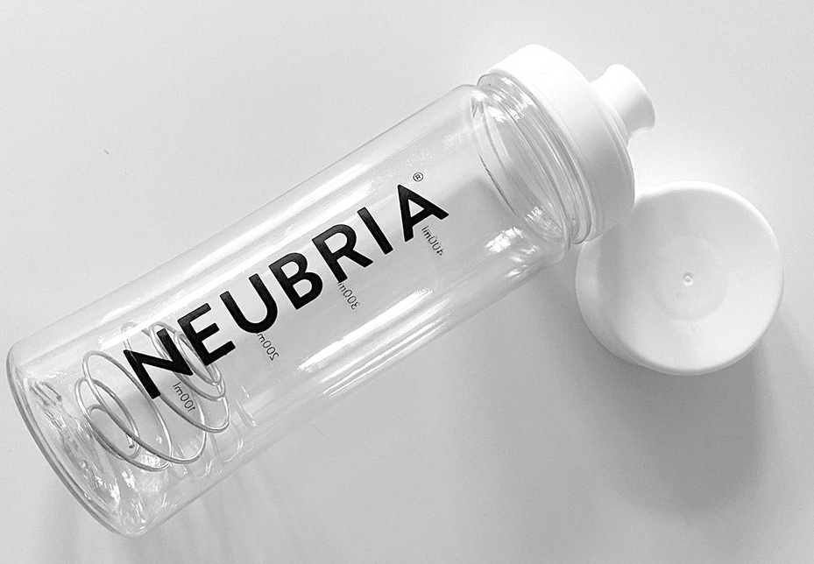
PRODUCT DESCRIPTION | UNIT SIZE | UNIT PRICE | BARCODE
NEUBRIA COGNIFUEL SHAKER BOTTLE | 400mL | $2,795.00 | 5060552880791

